Slide 1
LINEAR REGRESSION DEFINED
Linear regression is the study of linear relationships between variables.
It models the relationship between a dependent variable y and one or more explanatory variables denoted x.
Simple linear regression uses only one explanatory variable.
Multiple linear regression uses more than one explanatory variable.

Slide 2
LINEAR REGRESSION
Exploring the concept of

Slide 3
WHAT IS IT USED FOR?
Three primary uses for regression analysis exist:
Casual analysis
The regression may be used to determine the strength of the effect that the independent x variable has on a dependent y variable.
Some questions may include what is the strength between dose and effect, sales and advertising spent, age and income.
Predicting an effect
It can help us determine how much the dependent y variable changes with a change in one or more independent x variables.
How much additional y results for each one additional unit of x?
Trend forecasting
It can predict future values, outcomes and trends.
What will the price of gas be 6 months from now?

Slide 4
LINEAR REGRESSION LINE EQUATION
Form of the linear regression line equation:
y = mx + b
x is the explanatory variable and y is the dependent variable
The slope of the line is m, and b is the intercept (the value of y when x = 0)
m and b are unknowns and require a dataset in order to determine their values

Slide 5
SOLVING FOR m AND b
y = mx + b
Solving for m and b is made quite simple through today’s programs and software and should never have to be calculated by hand.
However, the values can be computed by the following equations:
m = (Nxy_{sum}) - (x_{sum}y_{sum}) / (Nx²_{sum}) - (x_{sum}x_{sum})
b = (x²_{sum}y_{sum}) - (x_{sum}xy_{sum}) / (Nx²_{sum}) - (x_{sum}x_{sum})
Please note the value of N is the total number of elements (or trials in your experiment).

Slide 6
THE CORRELATION
Correlations shows how close the line fits the points found in any given experiment.
The correlation coefficient is R².
The closer R is to 1, the better the line fits the data.
Again there should be no need to solve for R² by hand, but the equation is as follows:
R² = (Nxy_{sum} - x_{sum}y_{sum}) ² / (Nx²_{sum} - x_{sum}x_{sum}) (Ny²_{sum} - y_{sum}y_{sum})

Slide 7
BRINGING IT ALL TOGETHER
The following table shows the median California household income from 2005 to 2015 as reported by the US Census Bureau. Draw a scatter plot and find the equation. What would you expect the median annual income of a California household to be in year 2025? What are the meanings of the slope and the y-intercept in this problem?
Year | Income
2005 | $51,755
2006 | $55,319
2007 | $55,734
2008 | $57,014
2009 | $56,134
2010 | $54,283
2011 | $53,367
2012 | $57,020
2013 | $57,528
2014 | $60,487
2015 | $63,636

Slide 8
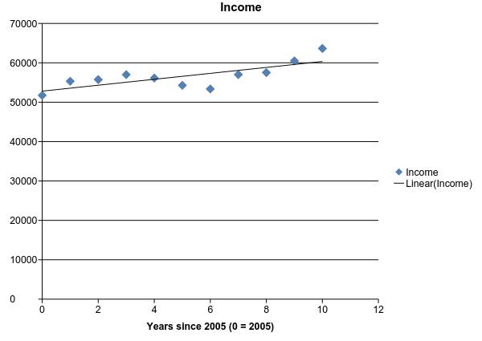
BRINGING IT ALL TOGETHER
Draw a scatter plot and find the equation

Slide 9
BRINGING IT ALL TOGETHER
What would you expect the median annual income of a California household to be in year 2025?
Using equation y = $751.85x + $52,811.00
Determine value of x
The value assigned to x is the number of years 2025 is from our starting point of 2005.
x = 20
y = $67,848.00

Slide 10
BRINGING IT ALL TOGETHER
What is the meaning of the slope?
The slope of the trend line represents the average change in the vertical variable that’s associated with a one-unit change in the horizontal variable.
In this case, the slope represents the average change in household income associated with each 1 year increase.
This means that for every one year since 2005, you can expect an average increase of $751.85 in household income.

Slide 11
BRINGING IT ALL TOGETHER
What is the meaning of the y-intercept?
The y-intercept is $52,811.36.
This means the average household income in 2005 (where the x variable is 0) is $52,811.36.
This is a slightly higher number than reported in the Census Bureau data.

Slide 12
QUESTIONS AND RESOURCES
Documentation on sklearn
Khan Academy - Linear Regression

